Slide 1

The Ohio State University

Slide 2
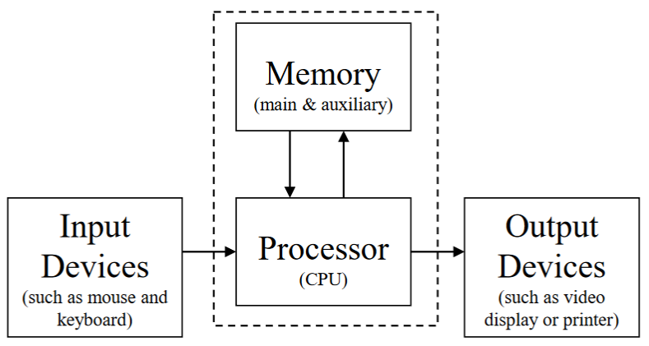




Computers (Hardware)
The Ohio State University

Slide 3
Computers (Hardware)
CPU = Central Processing Unit
  Executes instructions
Memory
  Stores (remembers) data and instructions
  RAM is short term memory
  Disks and solid state drives store long term memory
The Ohio State University

Slide 4
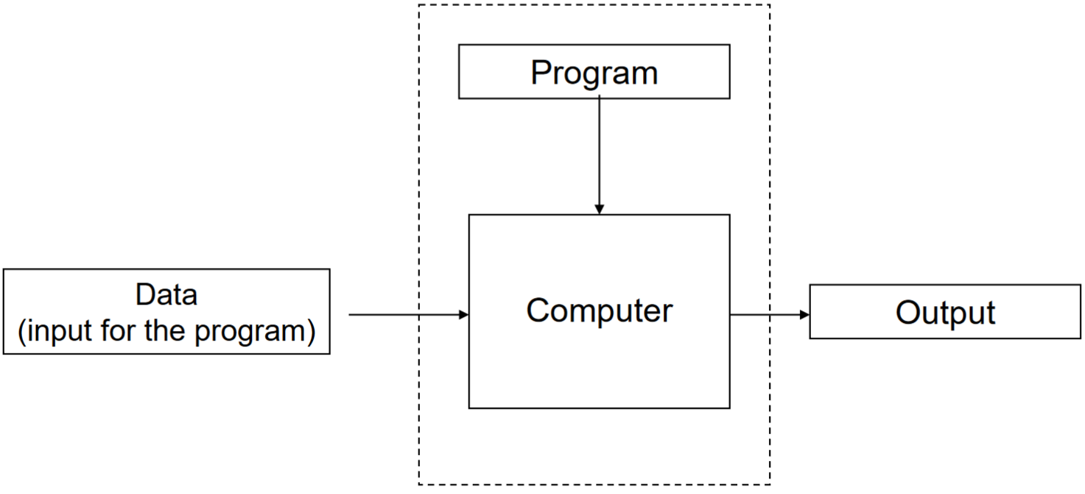
Computers (Software)
Program
  Sequence of instructions for the computer to follow (execute)
  For example, add two numbers and display the answer on the screen
The Ohio State University

Slide 5

Computer Language
How do we express our instructions to the computer?
The computer only understands a binary language, i.e. 0’s and 1’s, called machine language
  Bits and bytes
The Ohio State University

Slide 6



Ask a French Person
How do I express instructions to a French person?
Get a translator!
English
English & French
French
CSE1222: Lecture 1
The Ohio State University

Slide 7

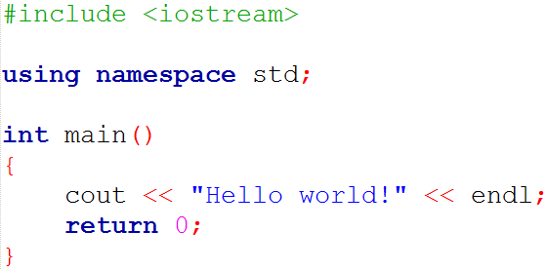

Computer Language
A compiler is a program that translates (converts) a program in an “English”-like language (C, C++, Java, etc) to machine language
  Under most operating systems, we could use the g++ compiler
C++
Machine Language
CSE1222: Lecture 1
The Ohio State University

Slide 8
C++ Language
Learning a programming language is like learning any foreign language
  Syntax – words, spelling, grammar rules
  Semantics – meaning, logic
C++
Machine Language
CSE1222: Lecture 1
The Ohio State University

Slide 9
Syntax and Semantics
Syntax
  Set of rules for forming “grammatically” correct statements
  The gcc compiler checks that your C++ program is grammatically correct
Semantics
  Refers to the meaning associated with syntax
  For example, the syntax cout is a command to display output to the monitor
The Ohio State University

Slide 10
First C++ Program - helloworld.cpp
#include <iostream>
using namespace std;
int main()
{
cout << "Hello World!" << endl;
cout << "Goodbye World!" << endl;
return 0;
}
This program display a welcome message and then a good bye message
Lets compile and execute (run) the program
  zyBooks chapter 14.24
  onlinegdb.com
The Ohio State University
Notes:
Explain header information #include and namespace.
Explain main().
Explain cout() and endl.

Slide 11
The main Function
…
int main()
{
cout << "Hello World!" << endl;
cout << "Goodbye World!" << endl;
return 0;
}
A function contains program statements between the curly braces
Program execution always starts at the main() function
  So this is required in every program!
You can invoke other functions from the main() function
  More on this later in the course
The Ohio State University

Slide 12
Program Statements
int main()
{
cout << "Hello World!" << endl;
cout << "Goodbye World!" << endl;
return 0;
}
Syntax rule: A program statement ends with a semicolon
There are three program statements in this function
The Ohio State University

Slide 13
Program Errors
Syntax Errors
  Misspelled something
  Forgot a symbol(s)
  Added an erroneous symbol(s)
  Also called compiler errors
The compiler only detects syntax errors
  You cannot execute a program with compiler (syntax) errors
The Ohio State University

Slide 14
Outputting with cout
…
cout << "Hello World!" << endl;
cout << "Goodbye World!" << endl;
…
The cout command outputs data to the screen (your monitor) to a console window - called standard output
It stands for “Console OUTput”
The Ohio State University

Slide 15
Outputting with cout
…
cout << "Hello World!" << endl;
cout << "Goodbye World!" << endl;
…
The << is known as the insertion operator in the context of the cout command
The first statement inserts the data "Hello World!" to the console window and endl directs the cursor to move the next line
The Ohio State University

Slide 16
Outputting with cout
…
cout << "Hello World!" << endl;
cout << "Goodbye World!" << endl;
…
The data "Hello World!" and "Goodbye World!" are text called strings
  To be more specific they are called literal strings because they are characters between double quotes
  The double quotes are called delimiters
The Ohio State University

Slide 17
helloworld3.cpp
#include <iostream>
using namespace std;
int main()
{
/* These statements use '\n' for newline in place of "<< endl" */
cout << "Hello World!\n";
cout << "Goodbye World!\n";
return 0; /* exit program */
}
The Ohio State University

Slide 18
String Literals
A string literal is a sequence of zero or more characters
Examples
  “hello”
  “Hello World”
    The blank space is a character
  “Hello\nGoodbye”
    Note: \n is the new line character
  “ “
    Contains a single blank space character
  “”
    The empty string contains no characters
The Ohio State University

Slide 19
First C++ Program - helloworld.cpp
#include <iostream>
using namespace std;
…
#include <iostream> is known as a preprocessor directive
It attaches C++ program code in a file, iostream, to our program when it is compiled
  This preprocessor directive is needed because it defines the meaning of cout
Syntax rule: The preprocessor directive DOES NOT end with a semicolon
The Ohio State University
Notes:
Explain header information #include and namespace.
Explain main().
Explain cout() and endl.

Slide 20
First C++ Program - helloworld.cpp
#include <iostream>
using namespace std;
…
using namespace std; allows us to write cout instead of writing the longer std::cout
A namespace collects definitions for objects (functions, classes, etc) under a single name
The definition of cout command exists in the namespace called std (standard namespace)
More on this later!
The Ohio State University
Notes:
Explain header information #include and namespace.
Explain main().
Explain cout() and endl.

Slide 21
Logic Error
// File is called logic_error.cpp
#include <iostream>
using namespace std;
int main()
{
cout << "2 + 2 = ";
cout << 5;
return 0; // exit program
}
The Ohio State University

Slide 22
Program Errors
Logic and Run-time are two other kinds of errors that can occur
  They occur after compilation is successful
  In other words, the compiler has already accepted your program as syntactically correct
Logic error
  The program executes to completion but gives wrong answers
The Ohio State University

Slide 23
Logic Error - helloworldError7.cpp
// Example of logical error
#include <iostream>
using namespace std;
int main()
{
cout << "Hello World!";
cout << "Goodbye World!";
return 0; // exit program
}
The Ohio State University

Slide 24
// Example of logical error
#include <iostream>
using namespace std;
int main()
{
cout << "Hello World!";
cout << "Goodbye World!";
return 0; // exit program
}
> g++ helloworldError7.cpp
> a.out
Hello World!Goodbye World!
>
The Ohio State University

Slide 25
Program Errors
Run-time error
  The program stops execution before completion and reports a problem
  Example: attempt to divide some number by zero
The Ohio State University

Slide 26
Chain output with cout
// math example
#include <iostream>
using namespace std;
int main()
{
cout << "1+2+3+4+5+6 = " << 1+2+3+4+5+6 << endl;
cout << "The average of 1,2,3,4,5,6 is " << (1.0+2.0+3.0+4.0+5.0+6.0)/6.0 << endl;
cout << "The reciprocal of 1+2+3+4+5+6 is " << 1.0/(1.0+2.0+3.0+4.0+5.0+6.0) << endl;
return 0; // exit program
}
The Ohio State University
Notes:
Note #include <cmath>

Slide 27
mathExample1.cpp
// math example
#include <iostream>
#include <cmath> /* File cmath contains math functions: sqrt, exp, sin, cos, ... */
using namespace std; /* cout, endl, sqrt, exp are in
the namespace std */
int main()
{
cout << "1+2+3+4+5+6 = " << 1+2+3+4+5+6 << endl;
cout << "The average of 1,2,3,4,5,6 is " << (1.0+2.0+3.0+4.0+5.0+6.0)/6.0 << endl;
cout << "The reciprocal of 1+2+3+4+5+6 is " << 1.0/(1.0+2.0+3.0+4.0+5.0+6.0) << endl;
cout << "The square root of 1+2+3+4+5+6 is "
<< sqrt(1.0+2.0+3.0+4.0+5.0+6.0) << endl;
cout << "e^(1+2+3+4+5+6) = " << exp(1.0+2.0+3.0+4.0+5.0+6.0) << endl;
return 0; // exit program
}
The Ohio State University
Notes:
Note #include <cmath>

Slide 28
Compiling and running mathExample1.cpp
> g++ mathExample1.cpp
> a.out
1+2+3+4+5+6 = 21
The average of 1,2,3,4,5,6 is 3.5
The reciprocal of 1+2+3+4+5+6 is 0.047619
The square root of 1+2+3+4+5+6 is 4.58258
e^(1+2+3+4+5+6) = 1.31882e+09
>
The Ohio State University

Slide 29
…
int main()
{
// These statements are incorrect
cout << "The average of 1,2,3,4,5,6 = " << (1+2+3+4+5+6)/6 << endl; // WRONG!
cout << "The reciprocal of 1+2+3+4+5+6 is " << 1/(1+2+3+4+5+6) << endl; // WRONG!
return 0; // exit program
}
> g++ mathError1.cpp
> mathError1
The average of 1,2,3,4,5,6 = 3
The reciprocal of 1+2+3+4+5+6 is 0
>
The Ohio State University
Notes:
Logical error.

Slide 30
C++ Program Template (for now)
#include <iostream>
using namespace std;
int main()
{
// program statements here
return 0; // exit program
}
The Ohio State University

Slide 31
C++ Program Template (with Math)
#include <iostream>
#include <cmath>
using namespace std;
int main()
{
// program statements here
return 0; // exit program
}
The Ohio State University

